Slide 1
MEMORY MATCHING GAME USING SFML (OOP PROJECT)
PROJECT MEMBERS
SYED MUHAMMAD AHSAN JAN (23PWCSE2309)
MIAN SAEED AHMAD (23PWCSE2319)
MUHAMMAD HUSAIN (23PWCSE2272)

Slide 2
Introduction
Brief overview of the game
Developed using SFML (Simple and Fast Multimedia Library)
Uses Object-Oriented Programming (OOP) principles
Involves memory skills and pattern recognition

Slide 3
Object-Oriented Programming (OOP) Concepts
Encapsulation:
Card class encapsulates properties like shape, color, and flipped status.
Abstraction:
The Card class provides a simplified interface for card behavior.
Polymorphism & Inheritance:
Not heavily used, but could be extended for different card types.

Slide 4
Game Levels and Progression
Levels increase dynamically
Each level presents a new shuffled set of cards
Challenges increase over time
Level completion is rewarded with encouraging messages

Slide 5
Hardship Levels
Hardship increases every 3 levels
Card viewing time decreases (from 5 seconds to a minimum of 3 seconds)
Encourages progressive difficulty and player adaptation
Game becomes more challenging as levels progress

Slide 6
Card Grid and Memory Mechanism
A 4x4 grid of cards (16 cards total)
Cards are initially hidden
Players flip two cards at a time to find matching pairs
If matched, they stay revealed, otherwise, they flip back

Slide 7
Randomization of Colors
Unique colors are randomly assigned to card pairs
Ensures variation across different game sessions
Utilizes std::random_shuffle for shuffling colors

Slide 8
Player Comments and Feedback System
Encouraging comments appear after each move:
Positive messages for correct matches (e.g., "You're on fire!")
Encouragement for mistakes (e.g., "Don't give up!")
Enhances user engagement and motivation

Slide 9
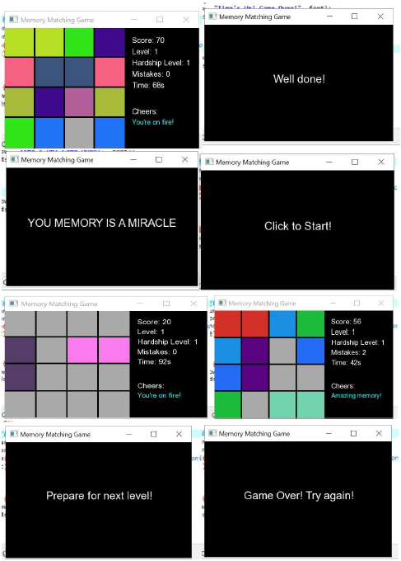
Random Pics Clicked During the Game

Slide 10
Winning and Losing Conditions
Losing conditions:
Score drops below -20 OR 10 mistakes are made
Time runs out
Winning condition:
Survive and complete level 10
Displays: "YOUR MEMORY IS A MIRACLE"

Slide 11
Conclusion
The Memory Matching Game combines OOP principles, game mechanics, and randomness to create an engaging experience.
Progressive difficulty and feedback system enhance user interaction.
Encourages memory improvement and cognitive skills.
Future scope includes additional levels, themes, and multiplayer options.

Slide 12
Thank You!
SUPERVISOR
Engr. Sumayyea Salahuddin

